Slide 1


GenZ Career Aspirations Analysis Report
Made By: Umesh Kumar

Slide 2


Slide 3



Slide 4
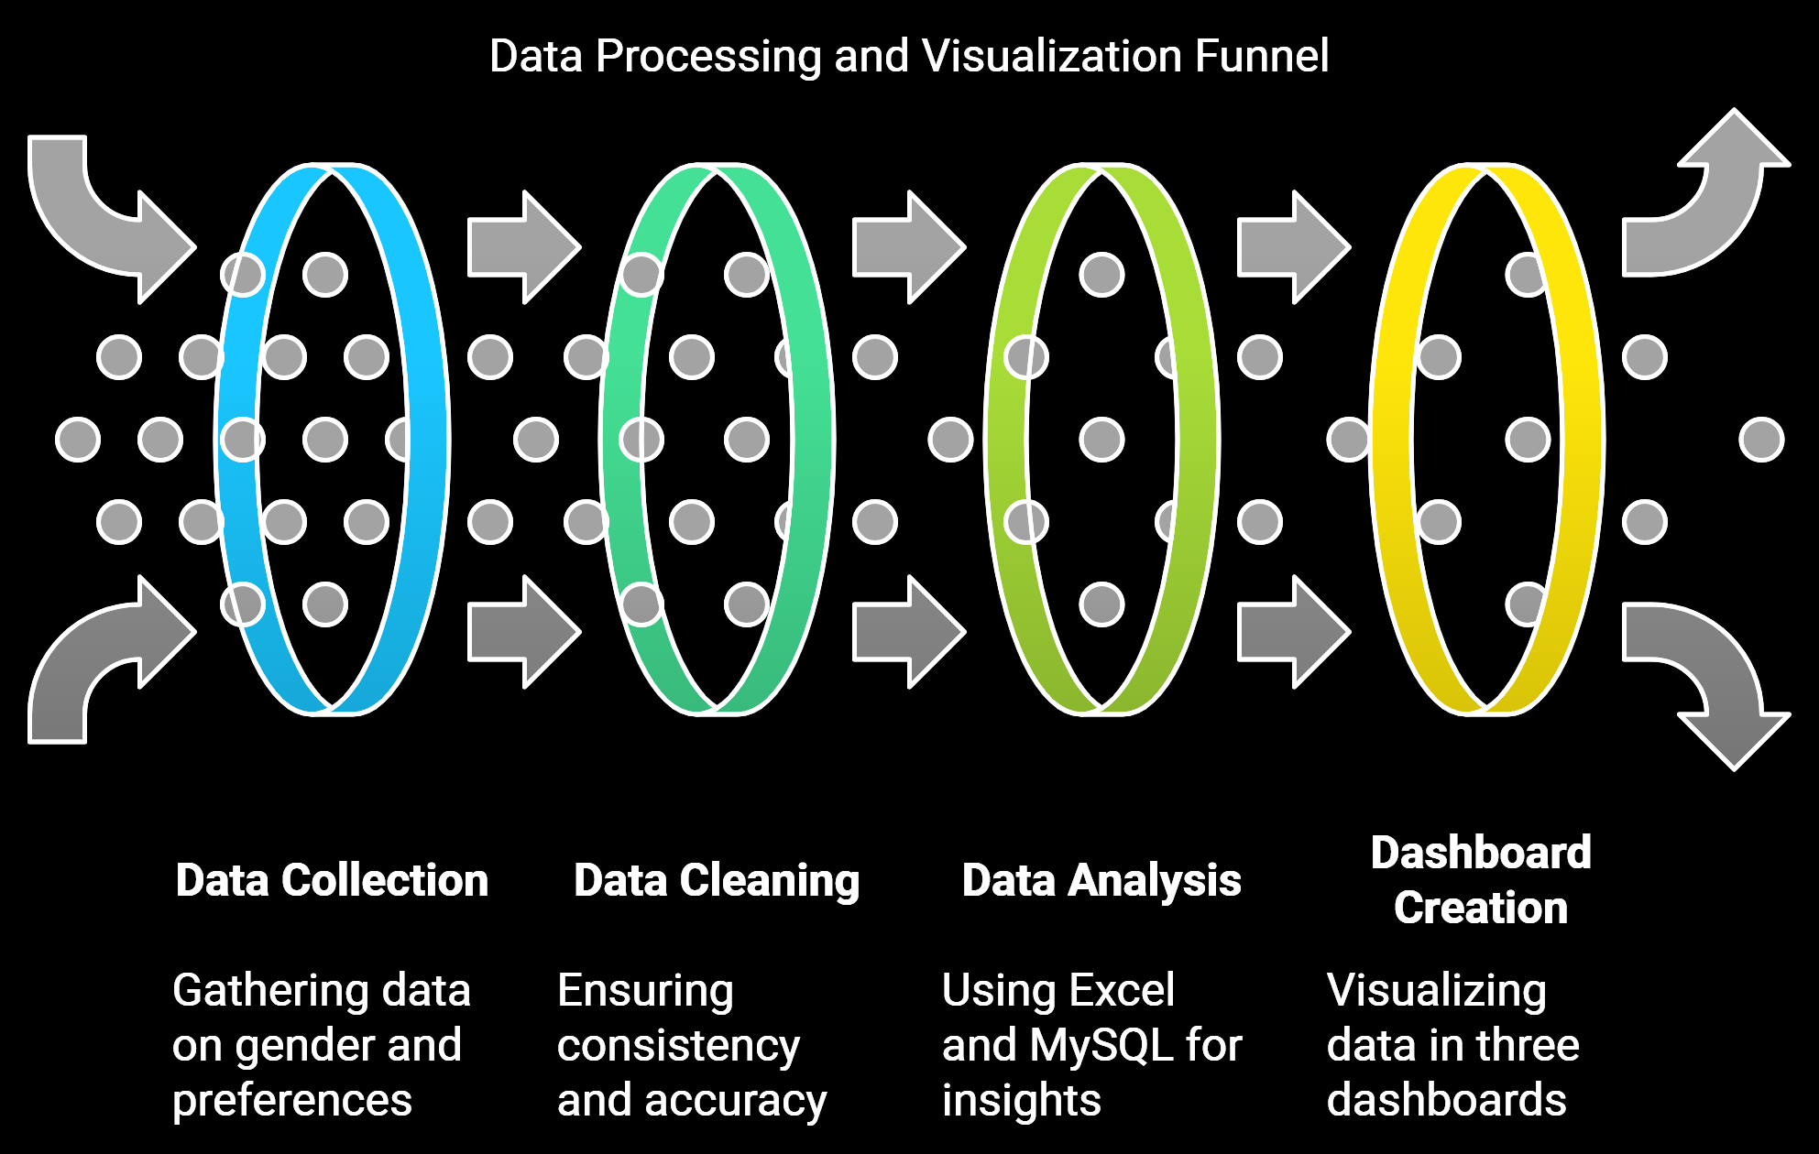

Slide 5


Slide 6
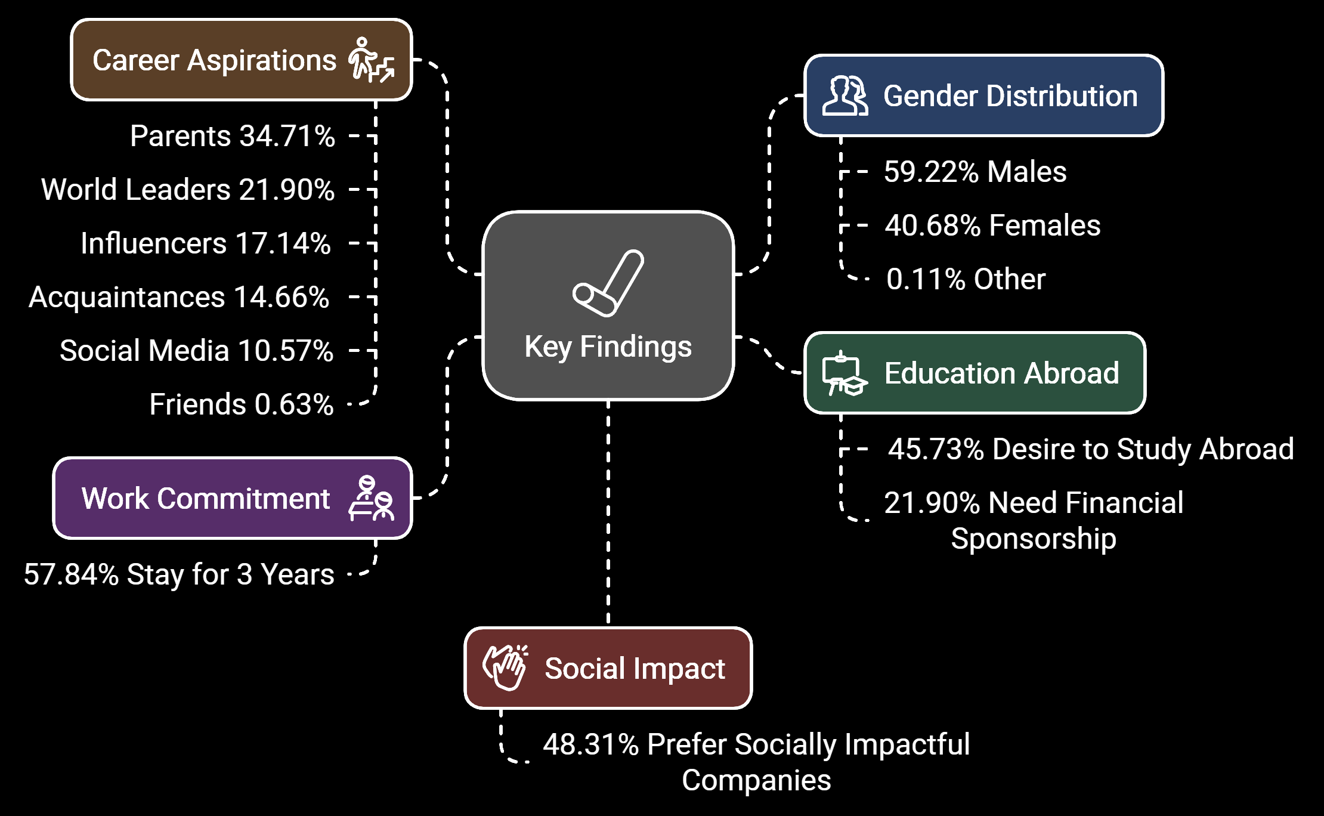

Slide 7



Slide 8


Slide 9


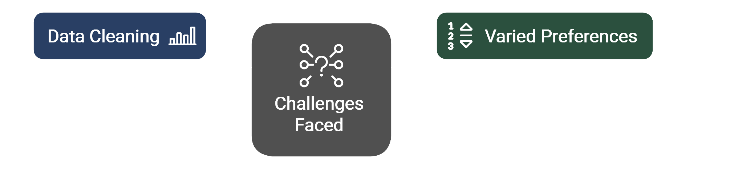

Slide 10
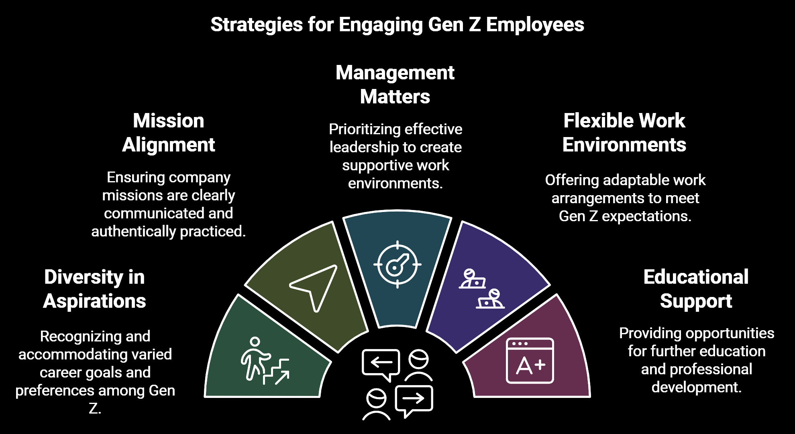

Slide 11
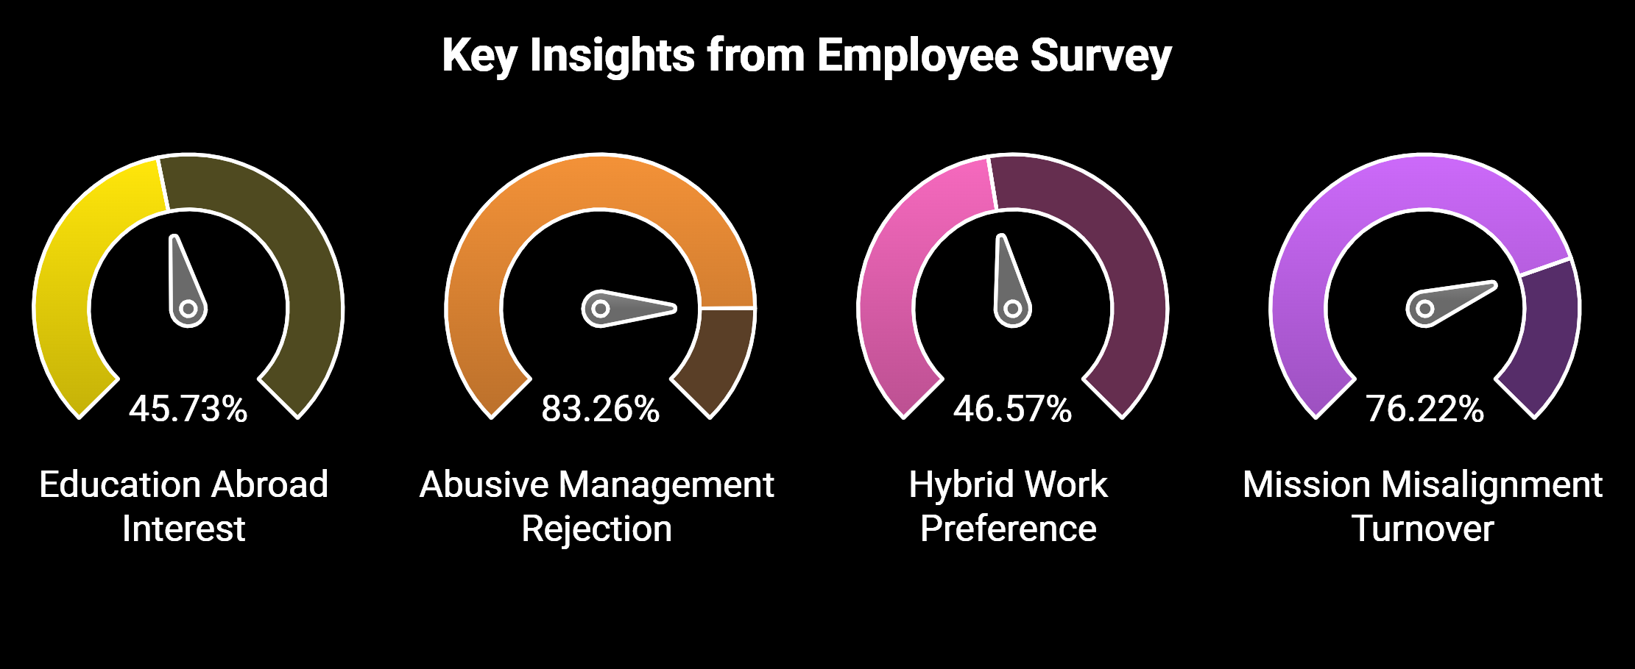


Slide 12



Slide 13

END OF REPORT

